Slide 1
Geolocation
Notes:
Geolocation is an important feature in HTML5, because it provides a standard way for an Web application to determine the current location of the device. This is particularly useful in mobile devices, and opens up a whole new realm of application possibilities.

Slide 2
Contents
Overview of HTML5 geolocation
Sources of geolocation information
One-off position requests
Repeated position updates
Demos folder:
Demos\11-Geolocation
Notes:
Section 1 sets the scene for the chapter with some essential concepts and theoretical considerations.
Section 2 summarizes the possible sources of geolocation information. In other words, how does a device physically determine its location?
Section 3 describes the Geolocation API for determining the one-off position of a device, and section 4 describes how to get repeated updates if the position is varying.

Slide 3
1. Overview of HTML5 Geolocation
Checking for support
Types of information available
How the HTML5 Geolocation API works
Additional geolocation information
Geolocation architecture
Notes:
HTML5 is being actively adopted by mobile platforms. The iPhone, Android, Nokia, and Windows Phone 7 are all based on the open-source Webkit browser engine, and these phones account for ~65% of smart phones sold.
Location awareness is a key feature in many web applications, and HTML5's Geolocation API satisfies this requirement.

Slide 4
Checking for Support
You can check whether your browser supports the Geolocation API
function testForGeolocationSupport() {
if (navigator.geolocation) {
alert("Your browser supports the Geolocation API.");
}
else {
alert("Sorry pal, your browser doesn't support the Geolocation API.");
}
}
Notes:
The code in the slide shows how you can determine if the browser supports the Geolocation API. You would probably do this at the start of your application, and then decide which features to offer to the user in the application.

Slide 5
Types of Information Available
The HTML5 Geolocation API supports two types of position request
One-shot position request
Repeated position updates
Typical uses of the Geolocation API:
Locate the user's current position, and give the user instructions on how to get to a new location
Track a user's movement (like RunKeeper) to see how far they've travelled in a certain time
Notes:
The Geolocation API allows you to perform a on-off request to get the current location, or to request ongoing updates about the current location. In each case, you provide a call-back function that is invoked as soon as the location has been established.

Slide 6
How the HTML5 Geolocation API Works
The HTML5 Geolocation API asks the browser on the underlying device to provide location information
The location is provided as latitude/longitude coordinates
As decimal numbers
Where am I ☺ ?
Latitude = 59.92
Longitude = 10.73
Latitude
0º = Equator
+ve = Northern hemisphere
-ve = Southern hemisphere
Longitude
0º = Greenwich Meridian
+ve = East of Greenwich
-ve = West of Greenwich
Notes:
Geolocation information is always expressed as a pair of latitude and longitude values, expressed as decimal numbers.
By the way, the coordinates shown on the slide are for Slottsparken, in the centre of Oslo ☺.

Slide 7
Additional Geolocation Information
HTML5 Geolocation also provides the accuracy of the location coordinates
Accuracy can vary dramatically, depending on how the underlying device obtained the geolocation info (see next slide)
Additional metadata may also be provided, depending on the underlying device (null if not supported by device)
altitude
altitudeAccuracy
heading
speed
Notes:
When you get geolocation information, you also get an indication about the estimated accuracy of these values. The accuracy can vary widely, depending on which physical mechanism the device used to get the location information.

Slide 8
Geolocation Architecture
Device
Internet
Browser
Web Server
Geolocation
application
1
2
4
External
Location
Service
3
Notes:
This is how geolocation works under the covers:
A user navigates to a location-aware application in the browser.
The web page requests coordinates via the Geolocation API. The browser intercepts the call and requests the user's permission to get this info.
The browser retrieves coordinate information from the device it's running on, using an appropriate mechanism (more on this later).
The browser sends the coordinates to a trusted external location service, which returns a detailed location that can now be sent back to the host of the HTML5 Geolocation application.

Slide 9
2. Sources of Geolocation Information
IP address geolocation information
GPS geolocation information
Wi-Fi geolocation information
Mobile phone geolocation information
User-defined geolocation information
Notes:
The HTML5 Geolocation API doesn't mandate which technology a device must to use to obtain location information. It just exposes an API for retrieving that location information. It's up to the device to choose the best way to retrieve the info.
Accuracy can vary greatly, depending on how the device retrieved the info. The following slides describe the options, and summarize the pros and cons of each approach.

Slide 10
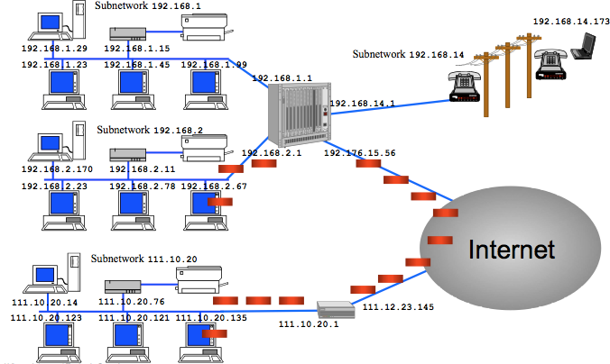
IP Address Geolocation Information
This is a rudimentary mechanism, can be wildly inaccurate
The user's IP address is looked up, and the physical address of the registrant is retrieved
If you have an ISP that provides you with an IP address, your location is often to the physical address of your service provider(!)
Notes:
Pros of this approach:
Available everywhere
Can be useful for localized advertising in a web site
Cons:
Can be very inaccurate

Slide 11
GPS Geolocation Information
Popular technique with mobile applications
A GPS position is acquired by acquiring from multiple GPS satellites
Notes:
Pros of this approach:
Typically very accurate
Can be useful for localized advertising in a web site
Cons:
Doesn't work well indoors
Acquiring a GPS signal can be slow (so GPS lookup is often performed asynchronously)
May require additional hardware

Slide 12
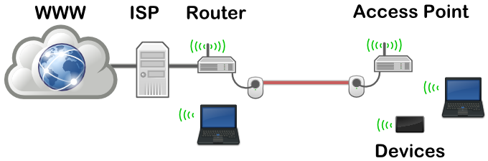
Wi-Fi Geolocation Information
Based on Wi-Fi access points
Determined by triangulating the location based on the user's distance from a number of known Wi-Fi access points
Mostly used in urban areas
Notes:
Pros of this approach:
Quite accurate
Works indoors
Quick and easy
Cons:
Not good in rural areas (too few Wi-Fi access points)

Slide 13
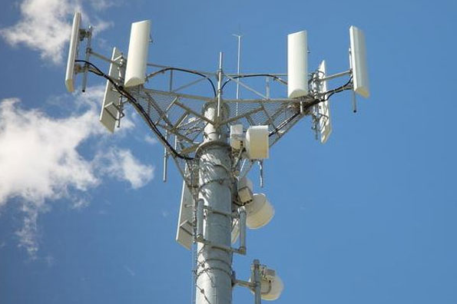
Mobile Phone Geolocation Information
Based on mobile phone towers
Determined by triangulating the location based on the user's distance from a number of mobile phone towers
Often used in conjunction with WiFi- and GPS-based geolocation
Notes:
Pros of this approach:
Reasonably accurate
Works indoors
Quick and easy
Cons:
Requires a device with access to a mobile phone or modem
Not good in rural areas (too few mobile phone towers)

Slide 14
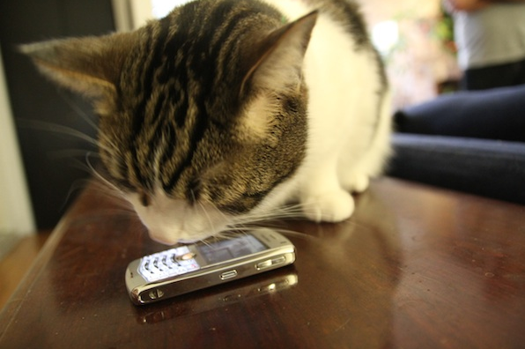
User-Defined Geolocation Information
Based on information entered manually by the user
An application can ask the user to enter their address, post code, or some other details
The application can then use that information to provide location-aware services
Notes:
Pros of this approach:
User might be able to supply more accurate location data than other methods
User-entry might be faster than detection
Cons:
Can be very inaccurate, especially if the user is on the move

Slide 15
3. One-Off Position Requests
Overview
Specifying position options
Defining a position callback function
Defining an error callback function
Worked example
Notes:
This section describes how to make a one-off request for geolocation information. Most of what you need to know is covered in this section.
It's also possible to request repeated updates, as we’ll see in the following section. As you'll see, it's mostly the same as a one-off request.

Slide 16
Overview
To make a one-off position request:
Required parameter:
PositionCallback
Function callback, called by browser when location data is available
i.e. location retrieval is an asynchronous task – why is this so?
Optional parameters:
PositionErrorCallback
Function callback, called by browser is any error occurs
You are strongly advised to handle this eventuality
PositionOptions
Allows you to fine-tune the way data is gathered
navigator.geolocation.getCurrentPosition( … params, see below … );
Notes:
getCurrentPosition() is an asynchronous function. When you call this function, it doesn't return geolocation information immediately, because it might take some time for the information to become available. Instead, you must supply a callback function, which the browser will invoke when the information is available.
You can also pass two optional parameters into getCurrentPosition(), specifying an error callback function and a PositionOptions object. We'll describe the PositionOptions object on the next slide.

Slide 17
Specifying Position Options
When you make a call to the Geolocation API, you can specify the following options to fine-tune the lookup
enableHighAccuracy (default is false)
timeout (default is infinity)
maximumAge (default is 0ms)
You set these options using shorthand object notation:
navigator.geolocation.getCurrentPosition(myPositionCallbackFunction,
myPositionErrorCallbackFunction,
{timeout:500, maximumAge:10000} );
Notes:
As described on the previous slide, you can pass a PositionOptions object as the third parameter into the getCurrentPosition() function.
You can set the following properties on this object:
enableHighAccuracy (default is false)
Hint to use the highest accuracy-detection mode.
Might not make any difference, or might consume more time and/or power.
timeout (default is infinity)
Maximum time (ms) the browser is allowed to get location data.
If data isn't available in this time, the error callback is called.
maximumAge (default is 0ms)
How old location data can be (ms) before browser must try to refresh.

Slide 18
Defining a Position Callback Function
As soon as the browser has geolocation data available, it calls your position callback function
The function receives an object that provides the geolocation data
Main properties on the geolocation data object:
latitude
longitude
accuracy (in metres)
Additional properties that might be available:
altitude
altitudeAccuracy
heading
speed
function myPositionCallbackFunction(geolocationData) {
…
}
Notes:
This slide shows a typical callback function for getCurrentPosition(). The function receives a geolocation data object that has latitude, longitude, and accuracy properties.
The geolocation data object also has additional properties that might provide additional details (or they might be null):
altitude (in metres)
altitudeAccuracy (in metres)
heading (direction of travel, in degrees relative to N)
speed (ground speed, in m/s)

Slide 19
Defining an Error Callback Function
If an error occurs during a Geolocation API call, the browser calls your error callback function
The function receives an object that has an error code
Position error codes:
PositionError.PERMISSION_DENIED
PositionError.POSITION_UNAVAILABLE
PositionError.TIMEOUT
You can observe errors by simply refusing the browser permission to get your position
function myPositionErrorCallbackFunction(errorObject) {
…
}
Notes:
This slide shows a typical error callback function. The function receives an error object that identifies one of the following causes for the error:
PositionError.PERMISSION_DENIED
PositionError.POSITION_UNAVAILABLE
PositionError.TIMEOUT

Slide 20
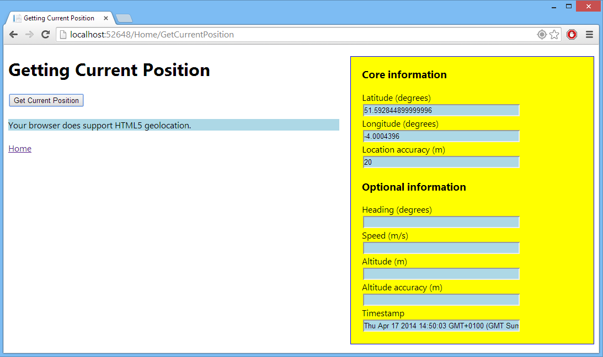
Worked Example
Open the demo project in Visual Studio
Run the app, and click the Get Current Position link
Then click the Get Current Position button
Notes:
The demo project shows how to perform one-off geolocation requests. Open the project in Visual Studio, run the project, and then click the Get Current Position button. After a short delay, the Web page will display your current location information.

Slide 21
4. Repeated Position Updates
Overview
Worked example
Notes:
This section shows how to retrieve ongoing updates about the current location. This is very similar to making one-off requests, except that your callback is invoked repeatedly (obviously!).

Slide 22
Overview
To make a request for repeated location updates:
The Geolocation service will call your position callback function repeatedly, as the position changes
To stop getting position updates:
var watchId = navigator.geolocation.watchPosition( … same params as before … );
navigator.geolocation.clearWatch(watchId);
Notes:
The previous section showed how to get one-off geolocation information via the getCurrentPosition() function. If you want repeated information, call watchPosition() instead. This function takes the same parameters as the getCurrentPosition() function, and returns an ID to identify this watcher.
If you no longer wish to receive location updates, call clearWatch() and pass your watcher ID as a parameter.

Slide 23
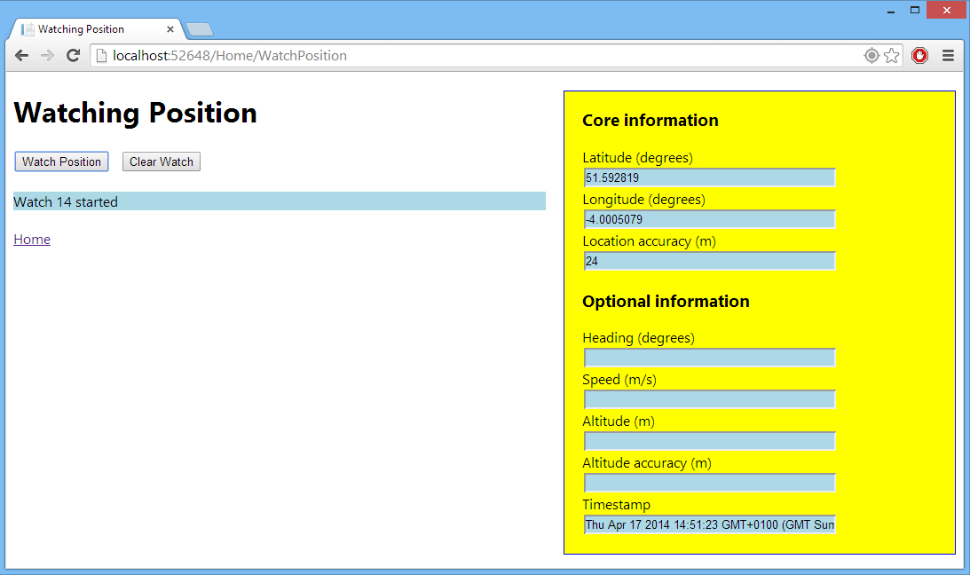
Worked Example
Open the demo project in Visual Studio
Run the app, and click the Watch Position link
Then click the Watch Position and Clear Watch buttons
Notes:
The demo project you ran earlier in the chapter also allows you to retrieve repeated location updates. Run the project again, but this time click the Watch Position button.
If you want to stop retrieving updates, click the Clear Watch button.

Slide 24
Any Questions?

